Slide 1

NER and Headline Text Generation for News Articles
“I didn't have time to write you a short letter, so I wrote you a long one.”
~ Mark Twain
“We wonder what it takes to summarize the whole letter down into a single sentence”
~ Saman, Sudhrity and Sri (w266 project team)
w266, Prof: Joachim Rahmfeld, Prof: Mark Butler
Notes:
Hi all, our teams topic is “NER and Headline Generation for News Articles”
We kind of know by now what it takes to write a short letter vs writing a long one after working on our papers ..
Through this project we are shorten a whole letter or an article down to 1 sentence and still keep good context

Slide 2
Introduction
motivation
Headline text generation is a special case of text summarization.
It is a bit of an extreme case: We need to distill down over 1K words into about 10 words (about 1% to 2 % of the original article size)
hypothesis
Reducing the article length by using stacking techniques such as NER sentence filtering, pre-summarization will improve the headline text generation performance when compared with the headline text generated from the first few sentences of the article text.
data
CORD-NER dataset covers named entity annotations for 75 fine-grained entity types for over 500K scholarly COVID articles. (Wang et al., 2020)
CoronaVirus news articles - used 765K of 3M dated 2019 to March 2020 - from IEEE - Ran Geva
CNN News (from CNN/Daily Mail) - 92K news article from 2006 to 2013.
Notes:
If you think about it, headline generation is an extreme case of summarization where we are distilling down about a thousand words into about 10.
Also, headlines are meant to be catchy and sometimes provoking
The 1st 3 sentences are generally used for summarization with the hope the article is summarized in the 1st 3 sentences
Our hypothesis is that reducing article length by filtering-in sentences with high value Named Entities and pre-summarization techniques will improve headline summarization performance when compared to just using the 1st 3 sentences
The datasets we used are:
For NER we used CORD-NER dataset consisting of I.O.B annotations across 75 NEs
For summarization, we used COVID news articles collected over a 4 month period and referenced on the slide
and separately, we also used the dataset of CNN news articles
Note that CNN news is across many topics vs COVID news is a specific topic and we used both separately for modeling and experimentation
……………
Sentences that include Names Entities - "who", "where," and "when" would likely be better candidates to form the text summary (Štěpán Műller, 2019)
Is that true for Headline generation?
News articles do not conform to a max token limit and transformer compute cost end up being quadratic.
Some models try to solve this problem by sliding and windowing attention (longfromer and bigbird)
Could we approach the problem by a multi stage summarization?

Slide 3
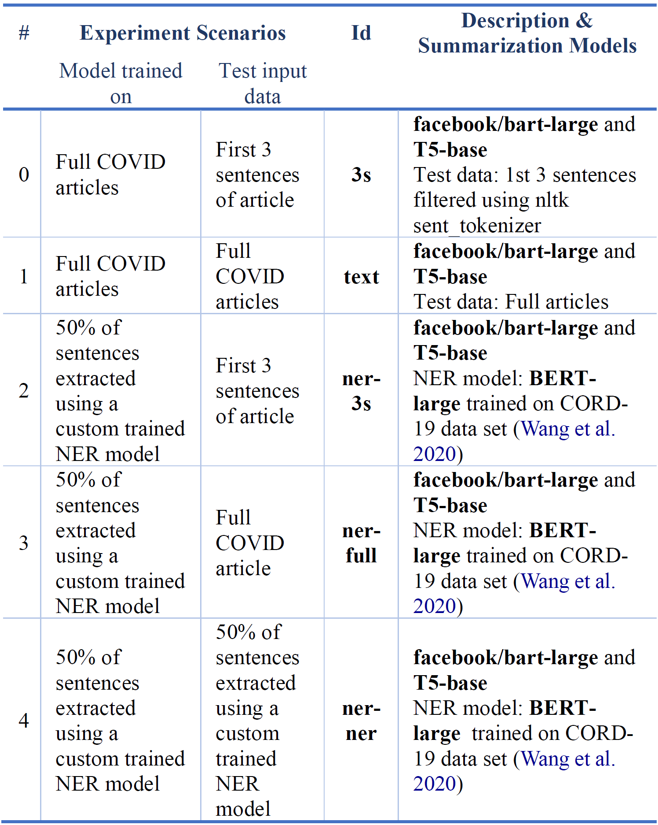
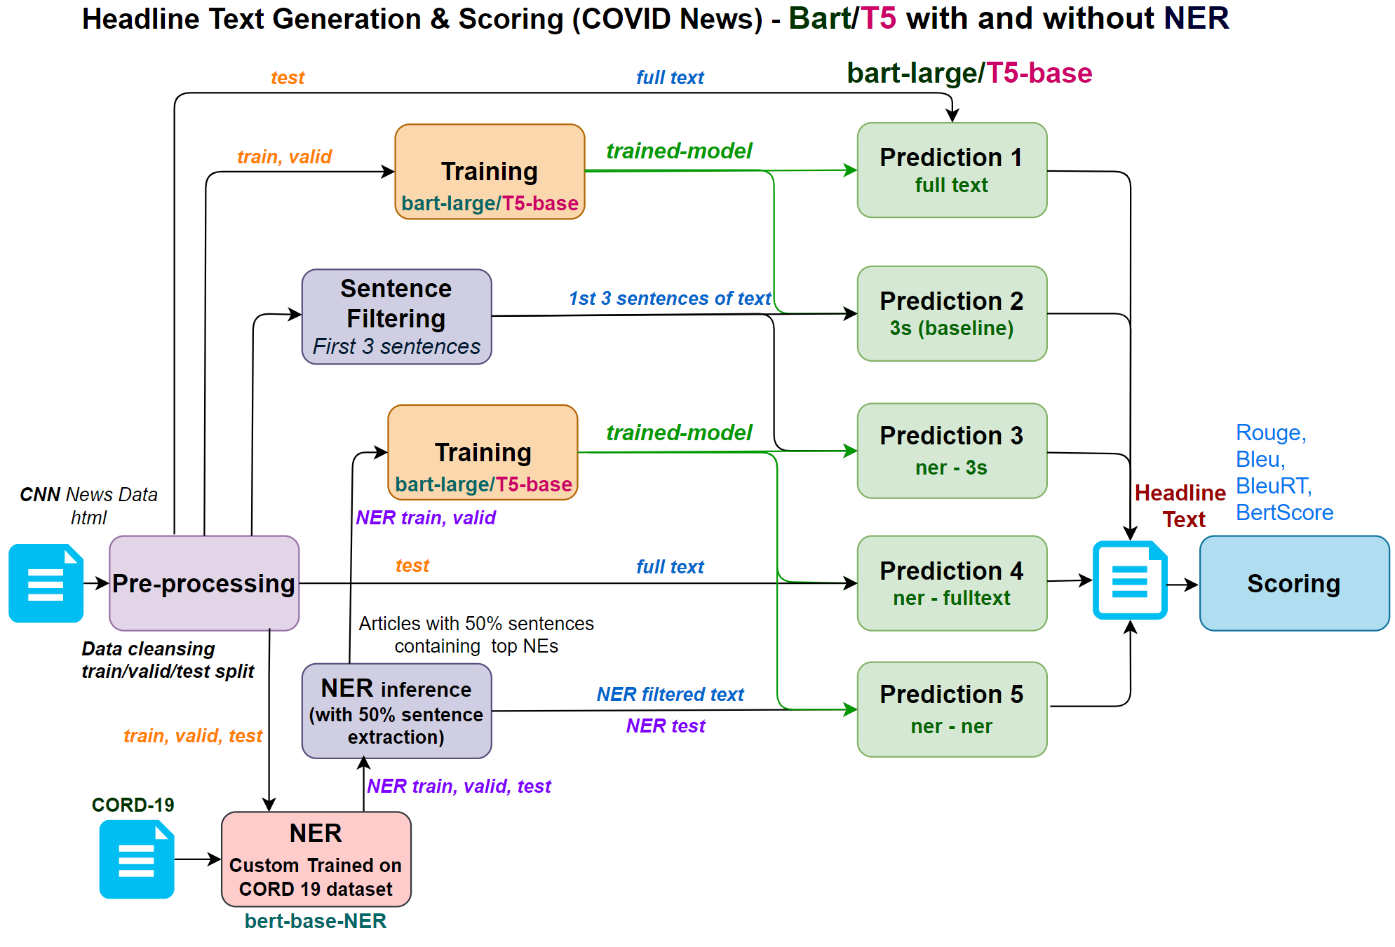
Methodology - models and experiments (COVID)
Experiments 1 to 10 of 38
Notes:
Sri
I will give a quick overview of the training and experimentation we conducted.
We developed different pipelines for COVID and CNN news and here is the overview is the COVID training and scoring pipeline
If you get your attention to the bottom left of the diagram:
we trained a BERT model with the CORD-19 data
one box - above - we took 75k COVID news articles and reduced the size of each article by picking sentences with high value Named Entities
We then trained multiple BART and T5 summarization models (shown in orange) with full articles as well as article shortforms (filtered for NEs)
We then predicted and scored each of the 4 summarization models with full article text as well as article shortforms with Named Entitiy filtered sentences
I will pause a moment before handing it over to Sudhrity for the next set of models

Slide 4
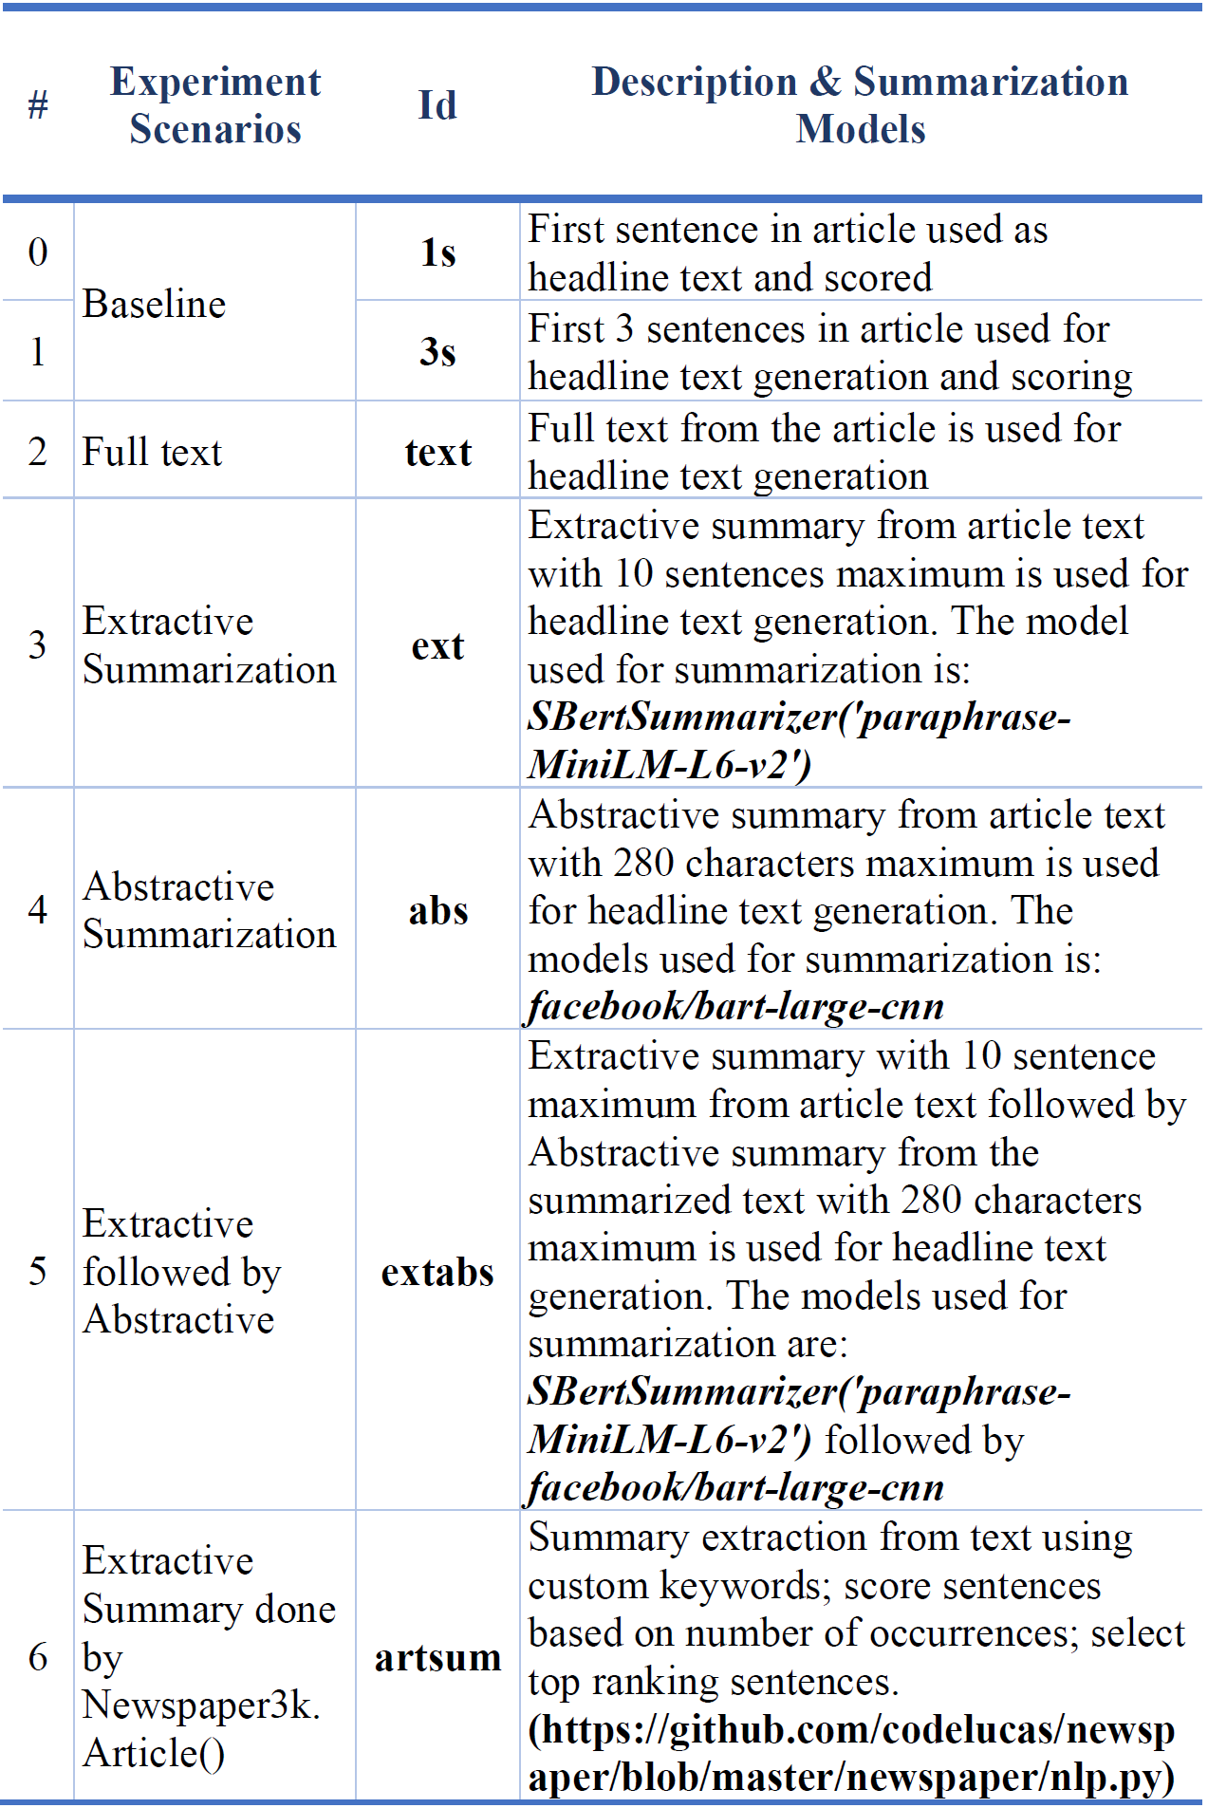
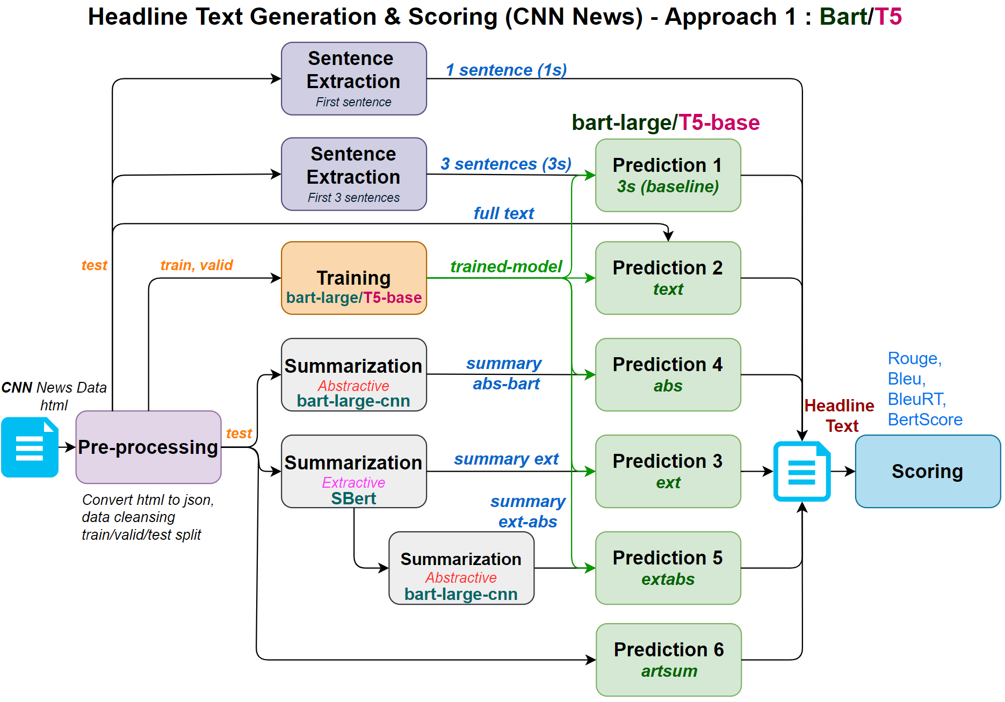
Experiments (CNN News)
Experiments 11 to 24 of 38
Notes:
Continuing with the experiments, for the CNN dataset, we had 0-6 or 7 scenarios. As in the COVID experiments, we started with using the first sentence as our headline followed by the first 3 sentences passed through the model to obtain our headline. This is our baseline.
We then passed the full text through the model to generate headline. This was followed by generating headline text from summaries. We started with extractive summary followed by abstractive and a combination of extractive and abstractive.
The CNN articles were available as html pages per article. We used a Newspaper3k: Article scraping & curation package to preprocess the article and converted the text and title to json.
This package also provided a method to do extractive summarization. We used this feature to generate article summary and passed this summary through our model to generate headline text.
We have used Ids to identify each of these scenarios as shown here. Read …
We have performed 4 sets of experiments for each of these scenarios (except the 1 sentence scenario, where it is just 2). The first set of scenarios is with full data without any Named Entity recognition. We performed training and prediction using bart-large and T5-base models.
For extractive and abstractive summarization, we used SBert and bart-large-cnn models respectively.

Slide 5
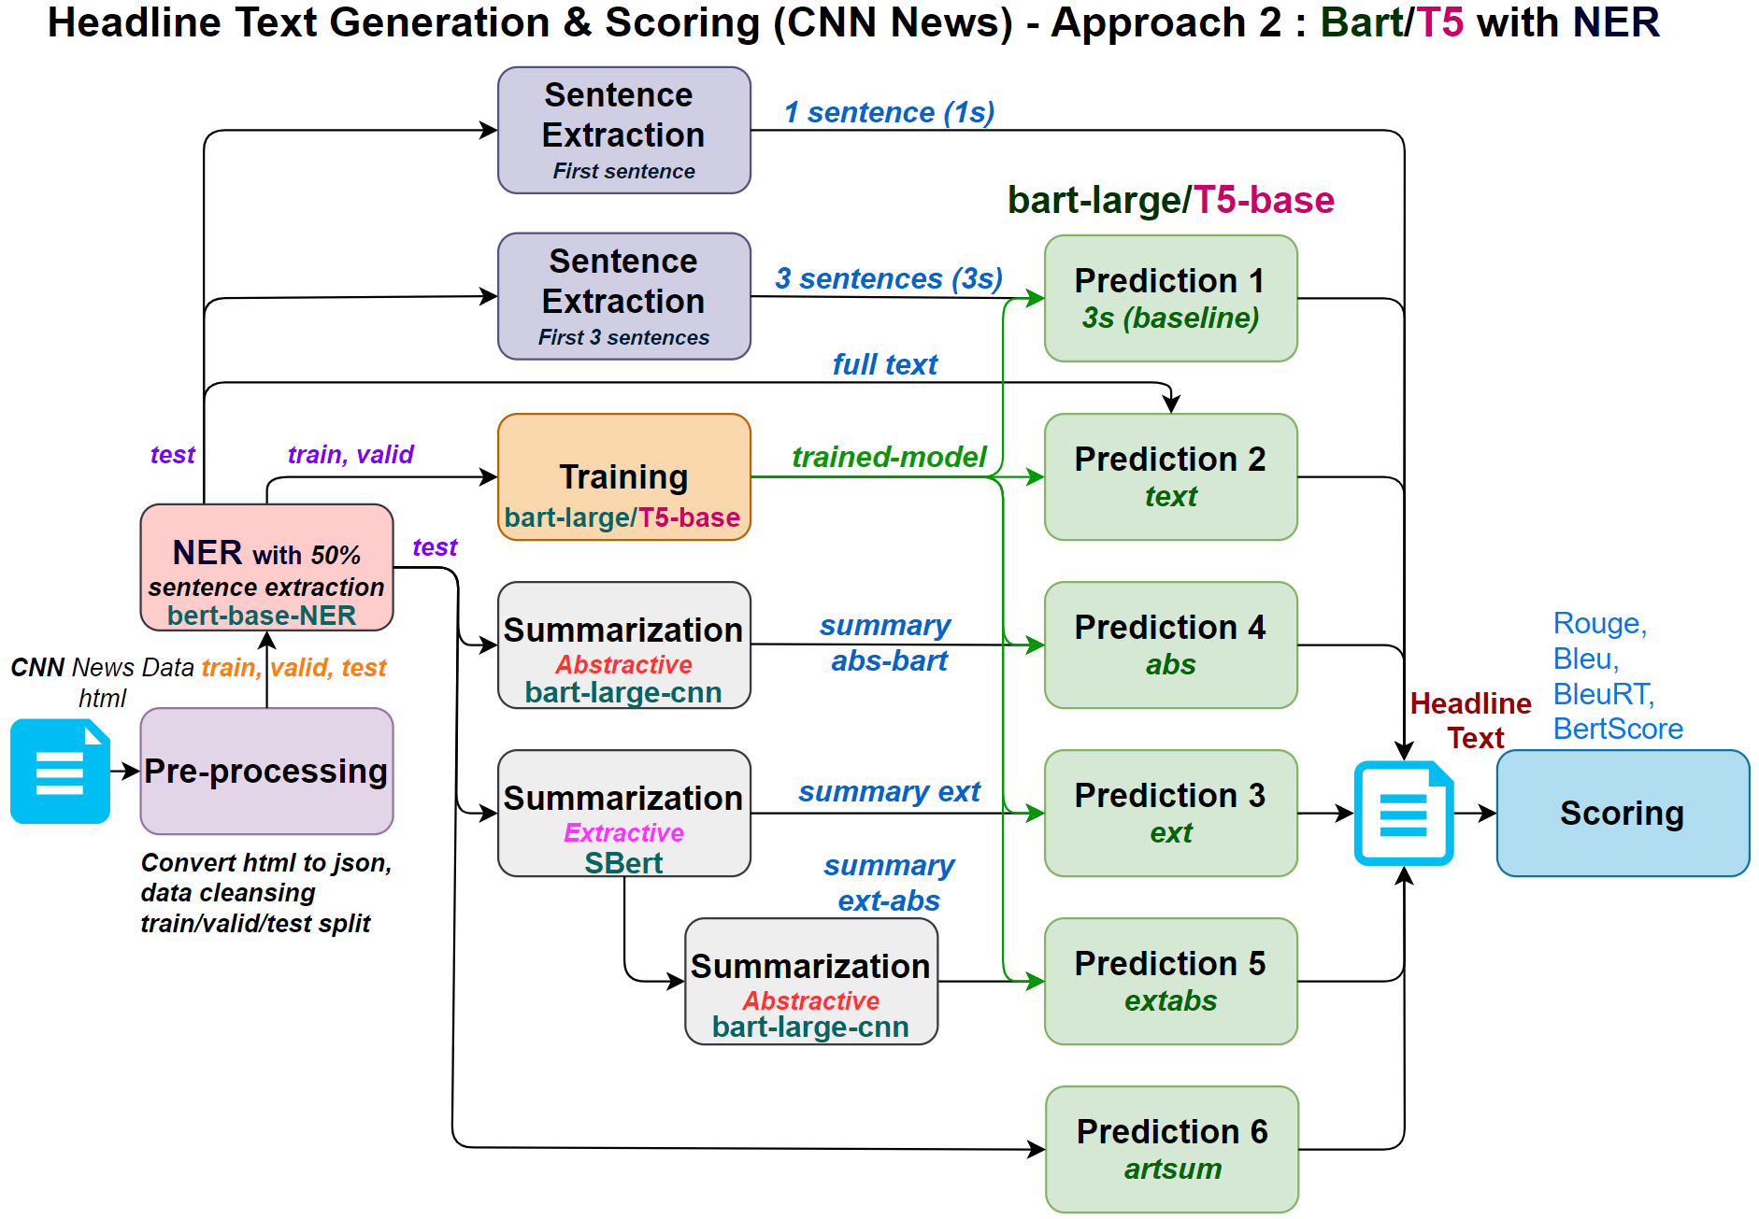
Experiments (CNN News)
Experiments 25 to 38 of 38
Notes:
We then used bert-base-NER model to extract named entities, and then scored the sentences based on the number of named entities contained in each sentence and filtered the top 50% of the sentences and passed through the training and prediction pipeline.
The scoring of the headlines were done using Rouge, Bleu, BleuRT and Bertscore.

Slide 6

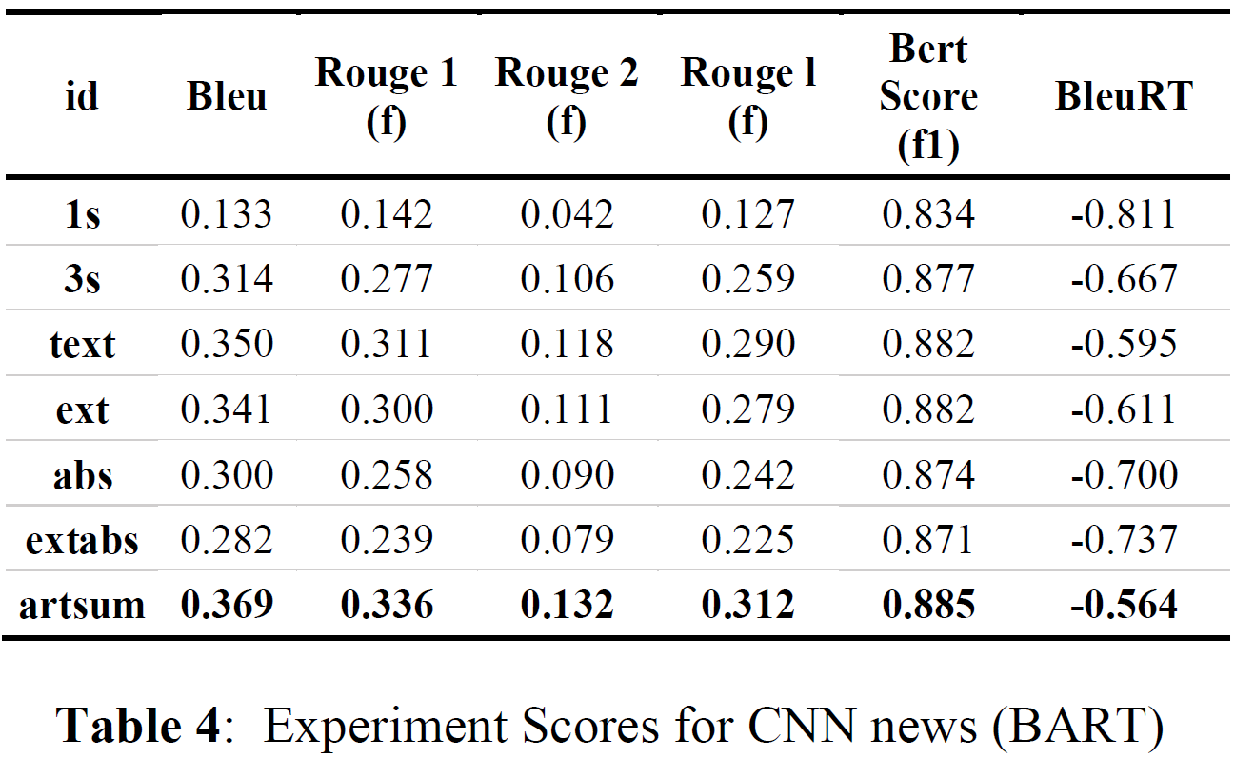
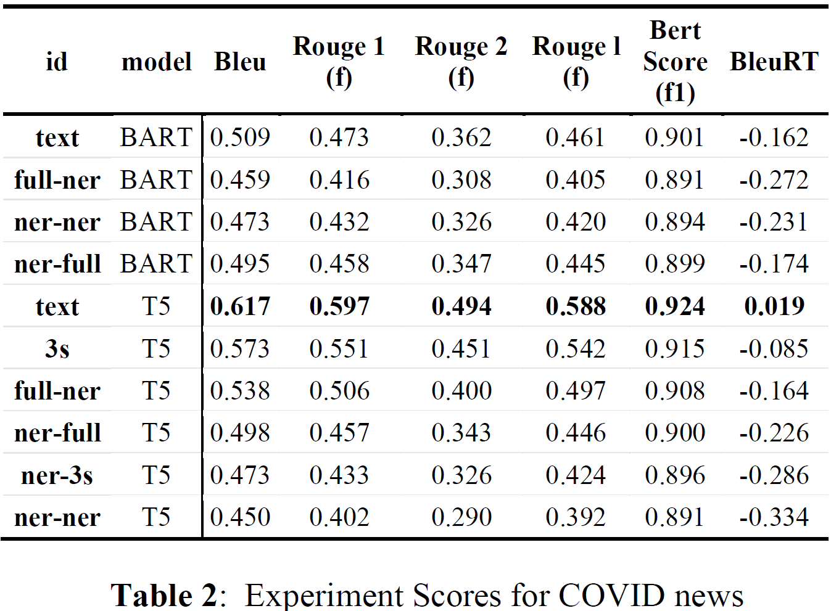
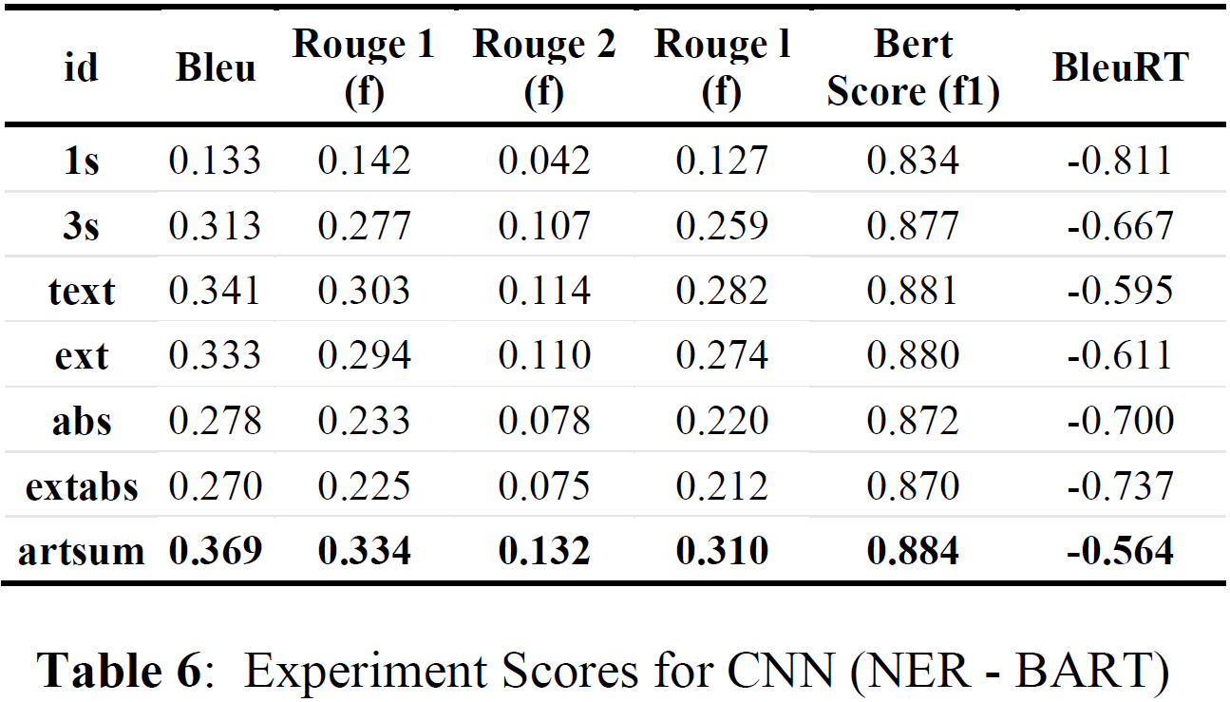
Results/Scores
COVID
Notes:
Let’s quickly review the results. On the left you see the scores from Covid news article experiments for both BART and T5 models. On the right, you see the results from CNN news articles for BART model only. The results from the T5 model are available in the paper.
For COVID news articles, the best scores were obtained when the headline was generated from the full text without filtering the article sentences based on NERs.
Rouge calculates the similarity between the candidate and the reference headline. We used the Rouge f1 score for comparison here. Bleu claims to measure correlation with human judgements on quality. Bleurt indicates to what extent the candidate is fluent and conveys the meaning of the reference. Bertscore computes a similarity score for each token in the candidate sentence compared to each token in the reference sentence. We used different scoring mechanism for evaluation to get multiple perspectives on the generated text.
Artsum, which is the headline generated from the article summary provided the best scores for the CNN news articles. This has been true for both BART and T5 models as well as for NER filtered articles for CNN.
Most of these scoring techniques are used to evaluate quality of document translation and/or summarization. What we have noticed, is that headlines generated from the models are sometimes closer to the article content than the original headline itself, but scores are the relatively low for the generated text.
Let’s look at an article headline …

Slide 7


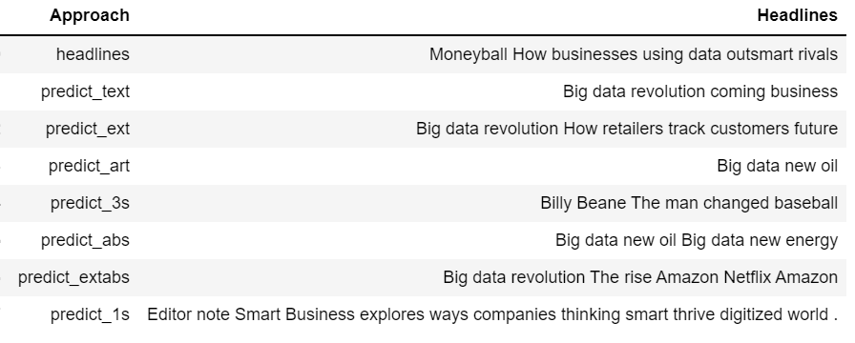

Results/Scores
COVID
Notes:
Many of you may have read the book or watched the movie Moneyball. The article was related to this story – how businesses are using big data to flourish.
Here, the article headline or the reference is the first line – Moneyball How businesses using data outsmart rivals
If we review the headlines generated, each of these generated headlines can be a headline for the article with or without minor tweaks. The author’s taste, preference, audience and other factors play an important role into what goes into the headline.

Slide 8
Observation and Inference
Our best performing model for COVID news is T5 full-full, vs. the best performing for CNN news is BART (artsum)
We got better scores on COVID news dataset compared to those on CNN news dataset:
COVID dataset contains more homogeneous articles that are on a specific topic
CNN news articles range across an unspecified number of topics and higher variation in the use of language as well as the context
Based on our results, our inference is that a multistage summarization and BART work better for general use-cases while T5 trains well on specific topics
According to the results for CNN dataset, BART - based scenarios gave better scores compared to T5- base, possibly because BART is trained as a denoising autoencoder dedicated to summarization
The performance of models based on NER filtering is not good
This could mean that the headlines in real life do not have a high density of NEs
We are losing some contextual information while performing important sentence filtering
Notes:
Saman
COVID News:
T5 trained and tested on full articles (id: text) gives the best scores
T5 - based scenarios gave better scores compared to BART - based scenarios.
Performance of our developed models based on NER filtering is not good
indicates we are losing some important contextual information while performing sentence filtering
could mean that the headlines in real life do not have a high density of NEs
Our best performing model for COVID news is T5 full-full, vs. the best performing for CNN news is BART (artsum).
COVID news dataset contains a more homogeneous set of articles that are on a specific topic and just from a 4-month period, while CNN news articles range across an unspecified number of topics over a ten-year period. Note that there would be a higher variation in the use of language as well as the context in
CNN when compared to COVID news (due to topic specificity as well as temporality). Based on this, our inference is that a multistage summarization and BART work better for general use-cases while T5 trains well or specific topics better.
Comparing scores across COVID and CNN news headline results, we infer that the approach of custom training topic-specific models is more effective than having more complex stacked models over data across multiple topics. According to the results BART - based scenarios gave slightly better scores compared to T5- base, possibly because BART is trained as a denoising
autoencoder dedicated to summarization.

Slide 9
Conclusions
We have conducted 38+ experiments
Our experiments indicate that there is a no unanimous winner among various transformers (BART and T5) -
use case, model development and stacking methods define how successful a transformer model implementation is
For COVID news - best model was T5 trained and scored using full article text
For CNN news - best model stages of interim summarization helped and Article Summary (artsum) yielded best scores
Notes:
Saman
Conclusion 1 minute

Slide 10
Questions
Notes:
Saman - or handoff to someone

Slide 11
APPENDIX

Slide 12
Experiments 11 to 24

Slide 13
Contributions
Custom-trained a BERT – based NER model on the CORD-19 dataset (Wang et al. 2020)
Created a pipeline that starts with reducing article size by 50% using custom NER predictions which are then used as inputs to custom train BART/T5 models for headline text generation
Custom-trained BART/T5 models on the COVID news dataset
Custom-trained BART/T5 models on the CNN news dataset
Notes:
Contributions and dataset - 1 minute

